Slide 1
Title: Road Accident Analysis and Dashboard Report (2021-2022)
Subtitle: Data Cleaning, Transformation, Analysis, and Dynamic Dashboard
Prepared by: Mayuri Khatpe

Slide 2
Project Overview
Objective: Analyze road accident data from the UK for 2021-2022 using Excel.
Data Source: Demo data obtained from Kaggle, manipulated for analysis purposes.
Deliverable: An interactive dashboard fulfilling client KPIs and providing insights.

Slide 3
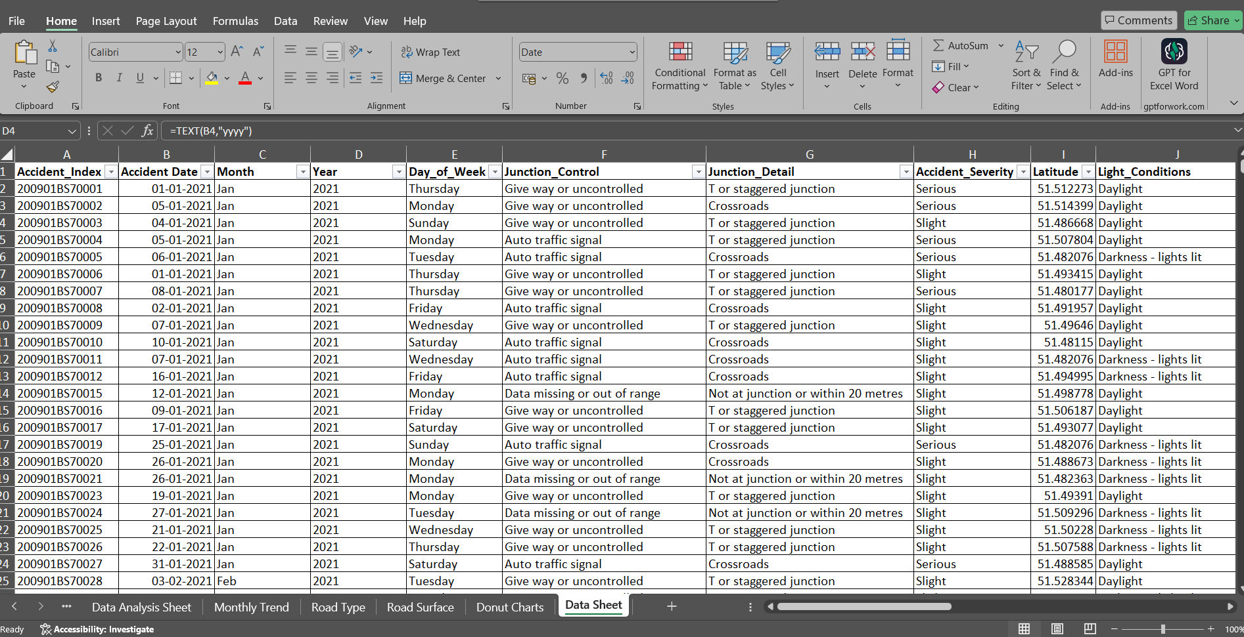
Data Sheet

Slide 4
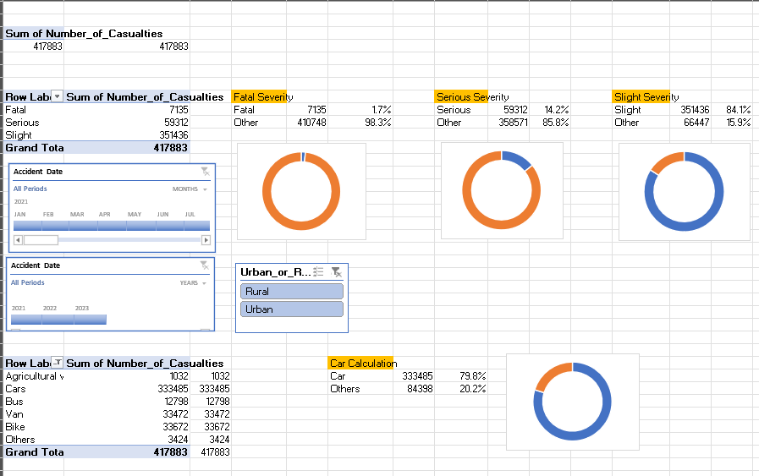
KPI

Slide 5
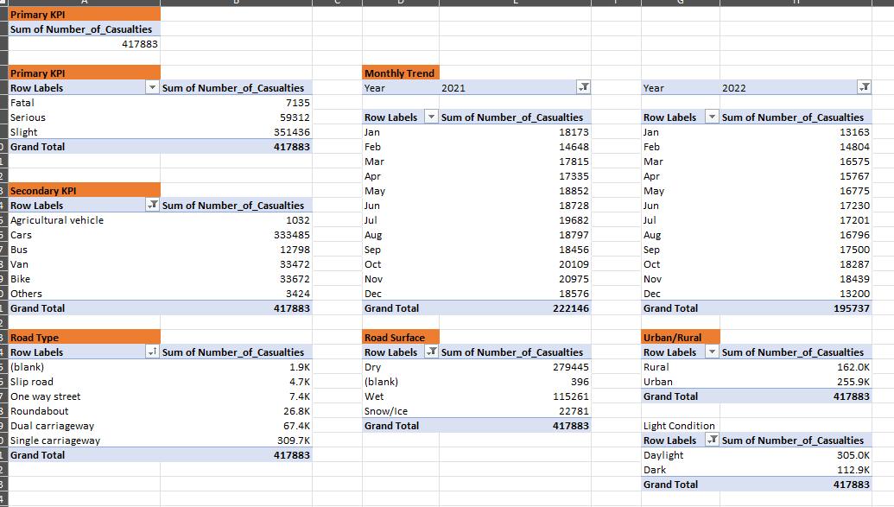
Data Analysis Sheet

Slide 6
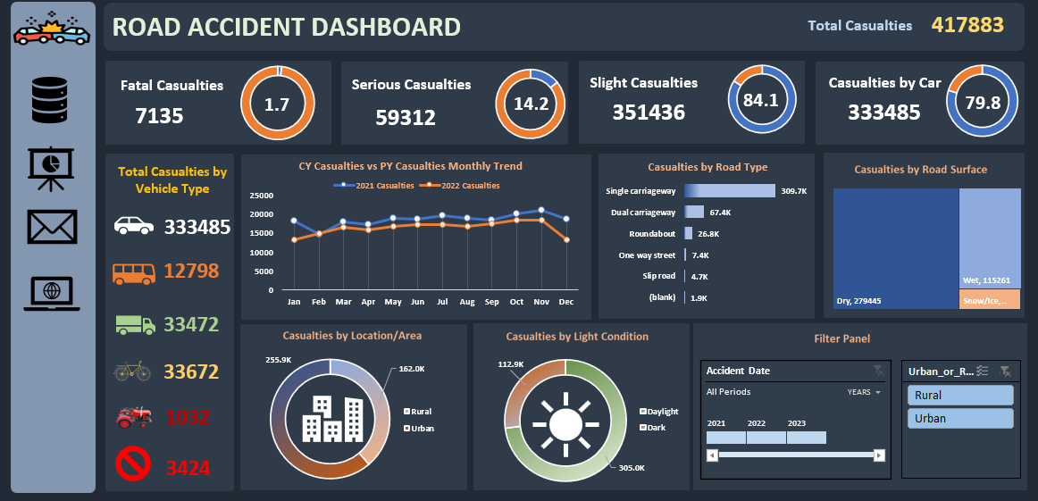
Dashboard

Slide 7
Key Performance Indicators (KPIs)
Primary KPI: Total casualties after accidents, along with the number and percentage of casualties categorized by accident severity.
Secondary KPI: Number of casualties categorized by vehicle type.
Monthly Trend: Comparison of casualties between the years 2021 and 2022.
Casualties by Road Type & Surface: Analysis of casualties based on road type and surface conditions.
Distribution Analysis: Examination of casualties by area, weather, and lighting conditions.

Slide 8
Stakeholders
The stakeholders for this project include-
Ministry of Transport
Road Transport Department
Police Force
Traffic Management Agencies
Public
Media

Slide 9
Methodology
Data Cleaning: The dataset was first cleaned by removing blank rows and eliminating any duplicate entries to ensure the accuracy of the analysis. Additionally, data types were adjusted where necessary to maintain consistency across all fields.
Data Processing: Excel formulas and functions were utilized to create new columns that provided additional insights. These customized columns were essential for creating accurate visualizations and meeting the analysis requirements.
Data Analysis: The cleaned and processed data was aggregated into pivot tables, which allowed for a structured examination of various trends and patterns. These tables were then used to generate charts that visually represented key metrics.
Data Visualization: Customized visuals, including bar charts, pie charts, and line graphs, were created to highlight the most important findings. Special attention was given to formatting these visuals for clarity and ease of interpretation.
Dashboard Creation: An interactive dashboard was developed, enabling users to dynamically explore the data. The dashboard includes filters and customizable options, allowing stakeholders to view specific details relevant to their needs.

Slide 10
Insights
Casualty Severity: The analysis revealed that slight casualties are the most frequent, while fatal casualties remain the lowest across both years. This indicates that while accidents are common, most do not result in severe injuries or deaths.
Vehicle Type: Cars and bikes are responsible for the majority of casualties, suggesting that these vehicle types are involved in the most accidents. This insight could be crucial for developing targeted road safety initiatives.
Monthly Trends: January consistently recorded the highest number of casualties in both 2021 and 2022. This seasonal trend might be linked to specific weather conditions or increased traffic during this period.
Road Type & Surface: Single-carriageways were found to have the highest number of casualties, particularly on dry road surfaces. This indicates that these types of roads might require additional safety measures or public awareness campaigns.
Conditions: Urban areas experience nearly double the number of casualties compared to rural areas. Additionally, fine weather conditions and daylight hours are associated with the highest number of accidents, suggesting that visibility and road use during these times might play a role.

Slide 11
Dashboard Overview
Interactive Features:
Dynamic exploration of casualty data.
Customization options for stakeholders.
Visual Elements:
Key charts and graphs.
Filters for year, vehicle type, road type, and more.

Slide 12
Thank You

